Slide 1

56th Charter Anniversary Symposium
RURAL BANKING : REINVENTING ITSELF FOR INCREASED RELEVANCE TO STAKEHOLDERS

Slide 2
HOME GUARANTY CORPORATION
“ Novel and Fresh Business Ideas ”

Slide 3
Mandates:
  To mobilize private funds for home lending
  To guaranty the payment of housing loans in the event of borrowers’ default
  To ensure sustainability of housing finance particularly for low-income familes.

Slide 4
Benefits of the HGC Guaranty
Risk Cover | 100% of the outstanding principal balance Guaranteed interest of up to 11%.
Tax incentive | Interest income on housing loans up to the extent of 11% is exempt from all forms of taxation.
Sovereign Guaranty | HGC guaranty carries the sovereign guaranty of the Republic of the Philippines (ROP).
Easing of Administrative Burden | Collection and foreclosure are shifted to HGC

Slide 5
Benefits of the HGC Guaranty
Zero-Risk Classification | HGC-guaranteed loans have zero risk weight. Banks are exempt from providing risk capital on HGC-guaranteed loans
Higher Loan Value | The Bangko Sentral ng Pilipinas allows a higher loan value, specifically 90% of appraised value of the collateral if it will be covered by an HGC guaranty. Otherwise, the loan is limited to 80% of appraised value.
Exemption from REL and SBL | HGC guaranteed accounts are exempted from the BSP’s requirement on maximum Real Estate Loan Limit and Single Borrowers Limit

Slide 6
HGC ‘s Guaranty Programs
Retail guaranty : covers the credit risk of individual housing loan borrowers
Developmental guaranty : covers the credit risk of loans for construction of housing projects
Guaranty on asset-backed securities : Bonds, Corporate Notes, Commercial Papers
Abot Kaya Pabahay Guaranty Program : covers the credit risk of Pag-IBIG, GSIS and SSS on socialized housing loans.

Slide 7
HGC Guaranty Operations
Guaranty Lines are extended to lenders of individual housing loans and construction loans of developers.
Guaranty premium is paid by the lenders to enforce the guaranty coverage.
In the event of default, HGC pays the lender in cash or debenture bonds.
The collateral or mortgaged property is assigned to HGC.
HGC recovers its guaranty exposure from the sale of the properties.

Slide 8
HGC’s Accomplishments
As of end of FY2012
Total Guaranteed: P77.44 Billion (equivalent to 51,114 housing units)
Outstanding Guaranty: P82.4 Billion (82,665 housing units covered)
Net Worth: P7.26 Billion
Guaranty Capacity: P145.29 Billion

Slide 9
HGC’s Accomplishments
As of end of FY2012
Income from Operations: P457.58M
Asset Disposition: P1.51Billion
( 2,140 units)
Remittance to the Bureau of Treasury: P51 Million

Slide 10
HGC GUARANTY PROGRAMS
Guaranty Program for Rural Banks
Guaranty Program for Small Loans for Home Improvement.
Employee Housing Programs
Bankers-Builders-Buyers(B-B-B) Program

Slide 11





B-B-B+ Program (Housing Finance Circle)
official website : www.bbbprogram.com

Slide 12
RURAL BANK PARTNERS
RB Lipa RB Cauayan
RB Tanza RB Rosario
Rang-ay Bank RB San Jose
RB Guinobatan RB Pagbilao
Bank of Makati 1st Macro
Banco Alabang RB Porac
Zambank AMA Rural Bank
Cantilan Mount Carmel
RB Mabitac

Slide 13
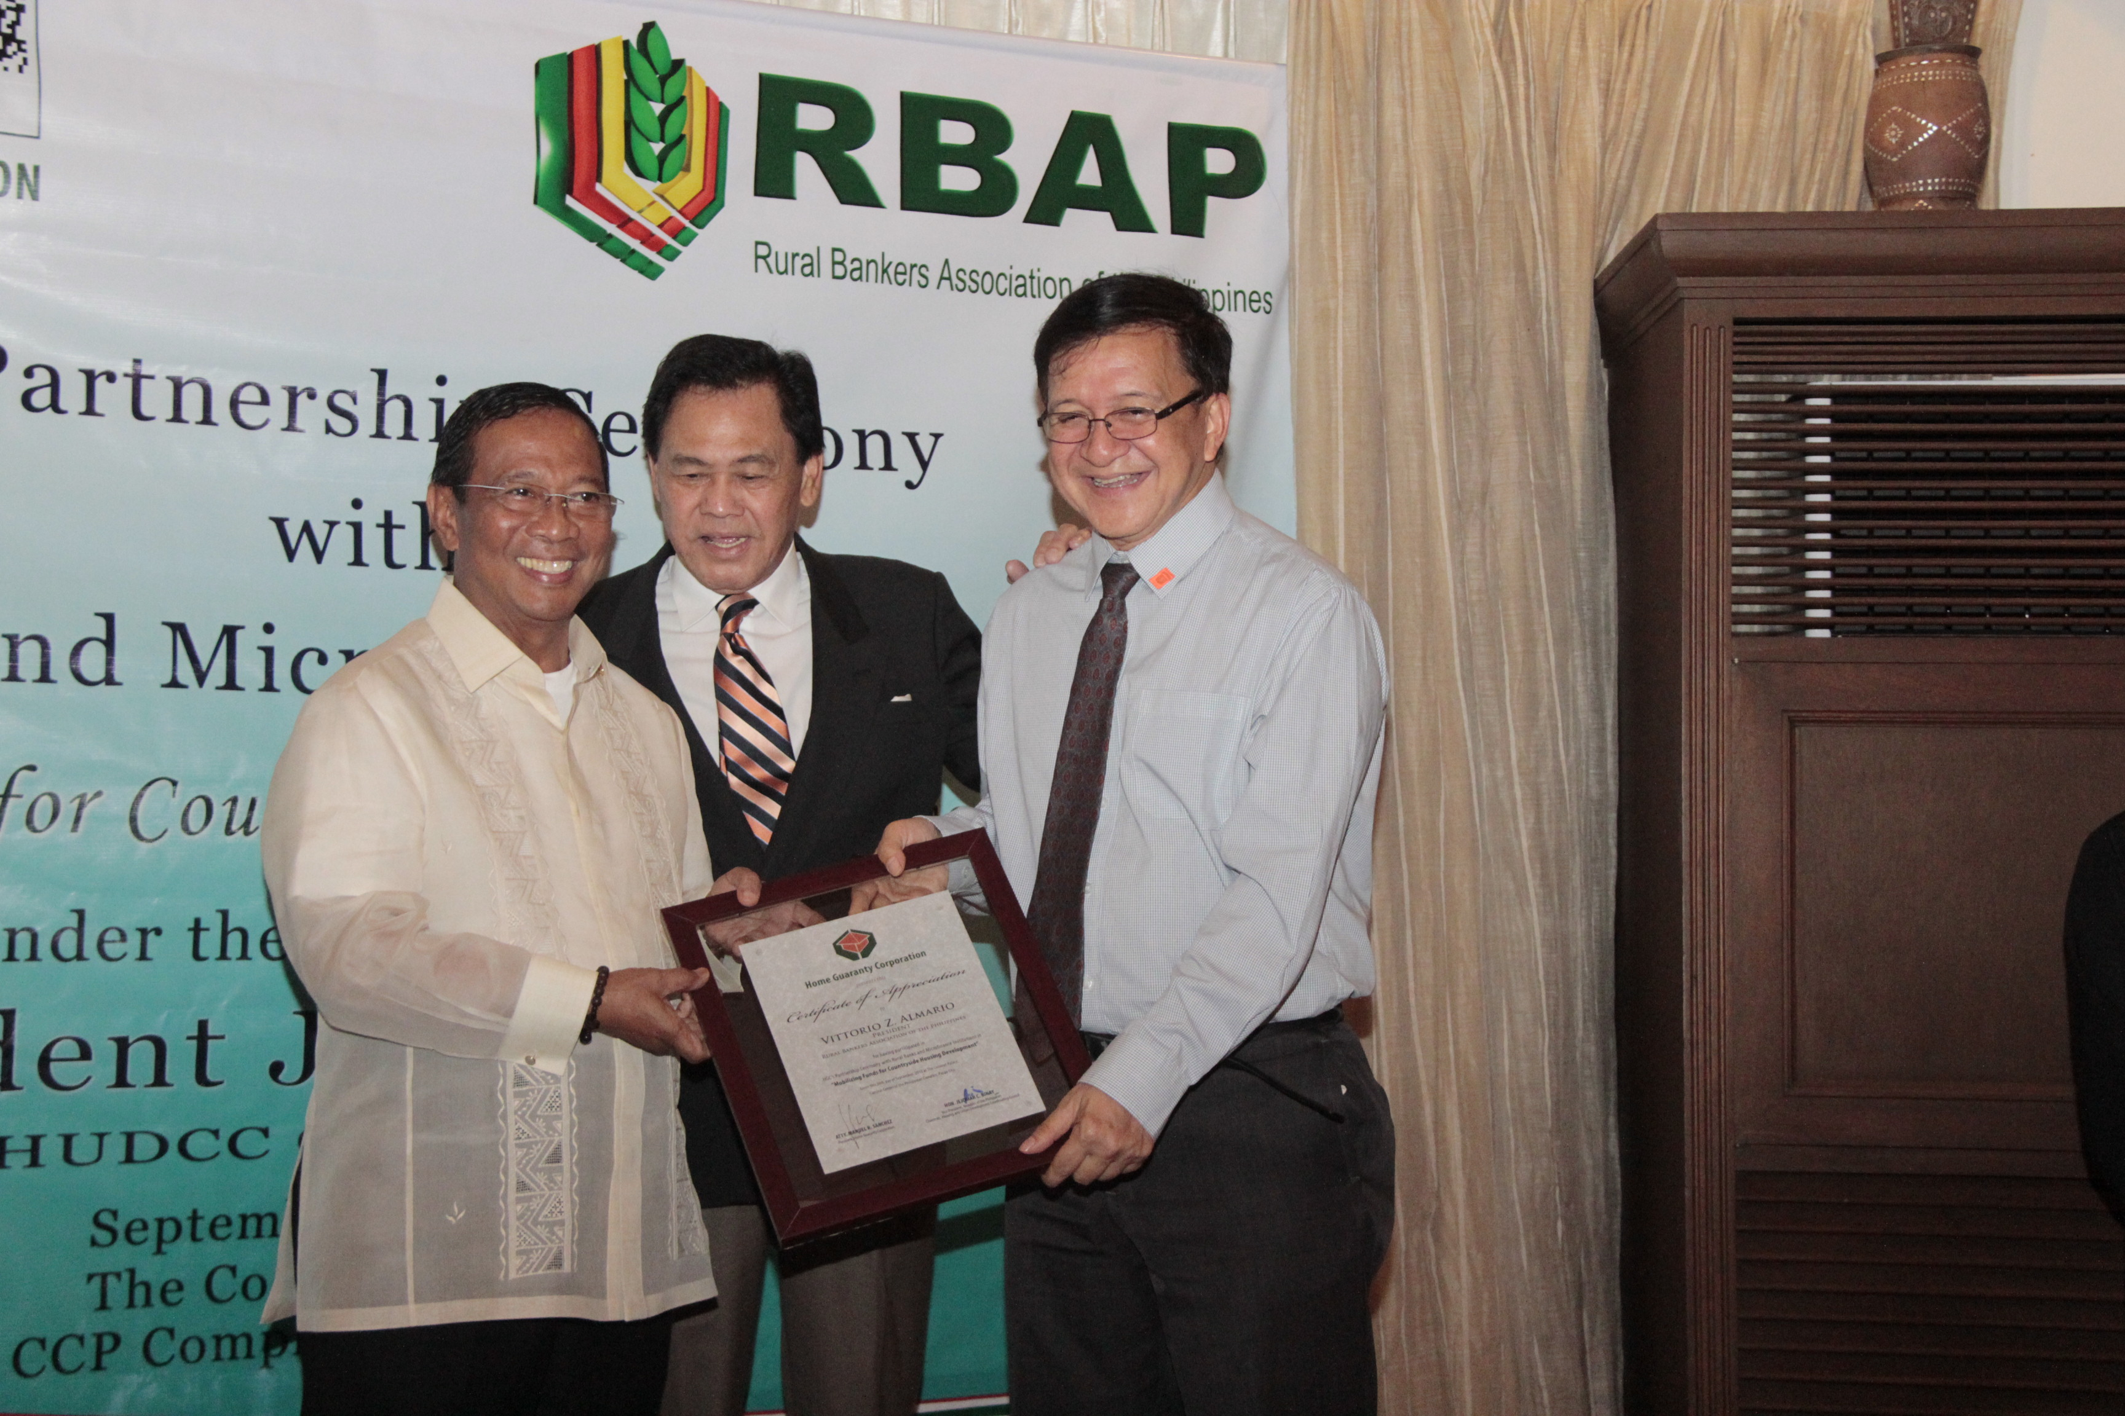


Slide 14
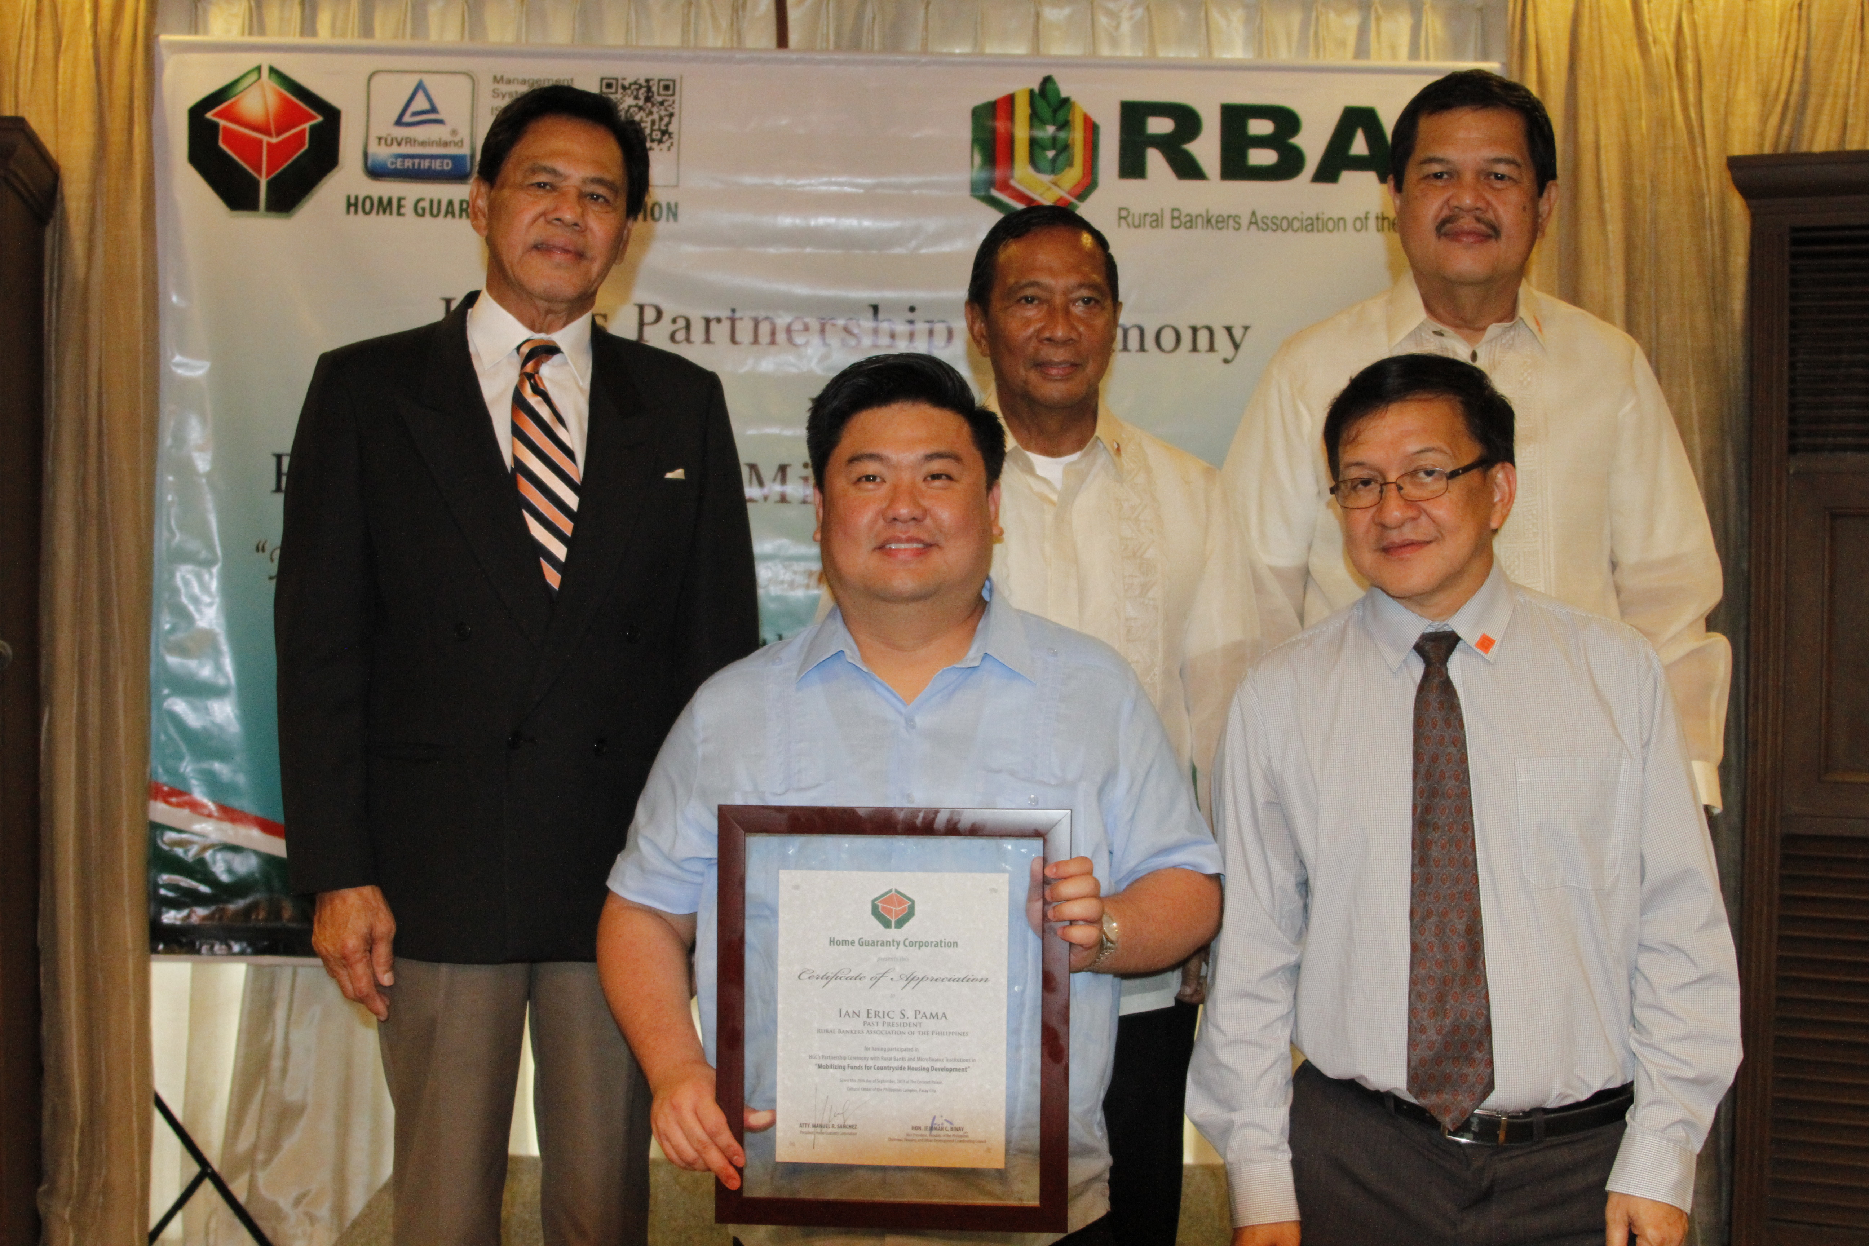

Slide 15
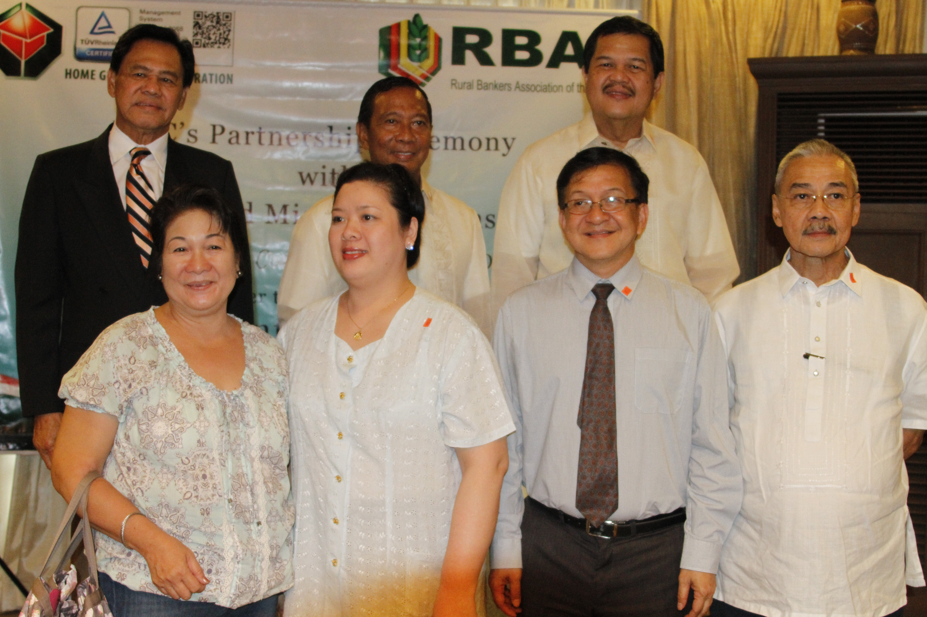

Slide 16
Thank You!

