Slide 1
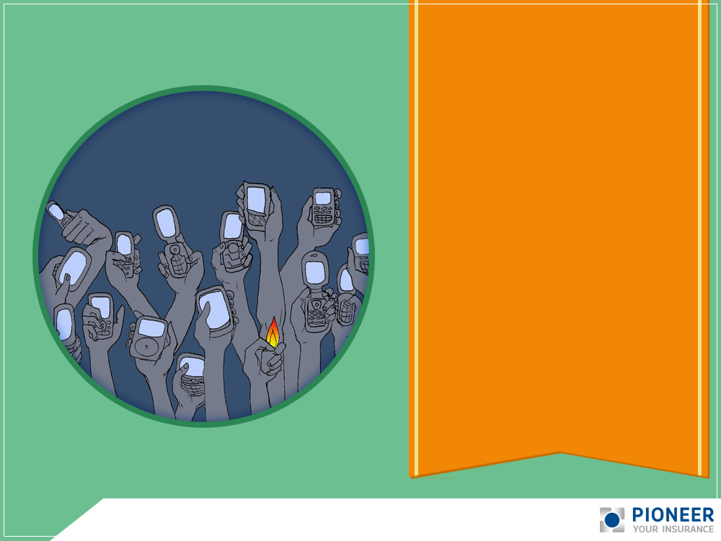
Microinsurance and
SMS Technology

Slide 2

2 billion
text messages are sent per day
Philippines is the “undisputed texting capital of the world”
85.5 million mobile phone users

Slide 3
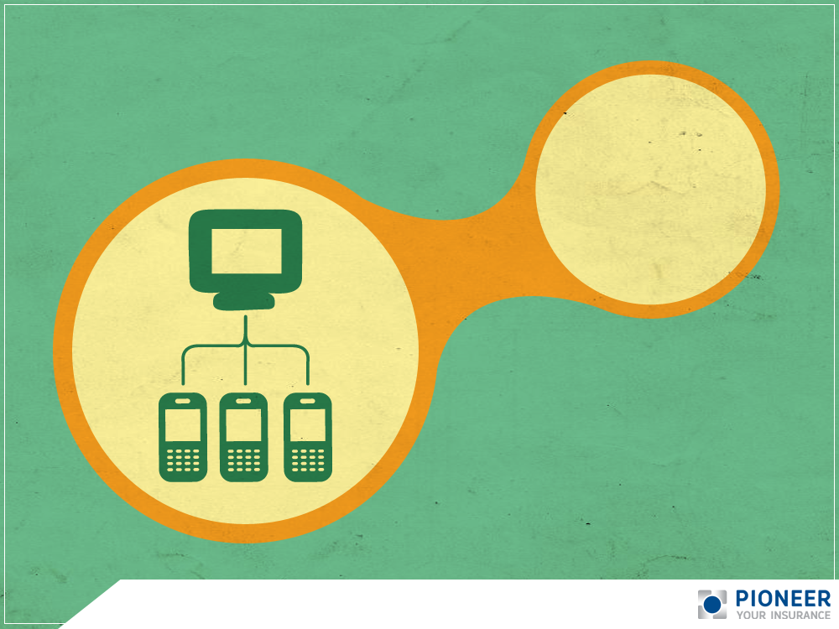
3x more cellphone users than there are Internet users
92% of cellphone users always keep their cellphone within reach

Slide 4

Vote for contestants
Text messaging is utilized by different industries
Get updates on basketball scores
Receive/retrieve your banking information

Slide 5

Filipinos
and
Insurance

Slide 6

Pinoys are familiar with the concept of insurance
….but is met with apprehension
There exists a wide gap to overcome in reaching out to Microinsurance market

Slide 7

The Challenge
Use a medium that makes insurance more accessible and available
Embark on the SMS project - a first of its kind in the Microinsurance Industry

Slide 8

The
SMS Project

Slide 9

Conceptualized in Feb 2012
To utilize SMS to inform bank client on its application, renewal and claim status
Not just for sales and marketing but to strengthen relationships

Slide 10


Pilot test with RGBI in Albay last June 2012

Slide 11
Sent messages on registration
and enrollment to
276 principal RGBI borrowers
Text message acted as a certificate of coverage
Received inquiries about insurance

Slide 12

  truncated content or a “language barrier”
Other recipients thought the message was a scam

Slide 13

  By end of 2012…
  10,173 RGBI received text messages of their insurance coverage
  Out of the recipients,
  2,628 responded to the
  SMS they received, showing interest and inquiry

Slide 14

Mobile numbers as mandatory requirement and conduct regular client orientations

Slide 15

Learnings

Slide 16

SMS service is a valuable tool in promoting RGBI’s MI operations
Projects the bank’s image as
“modern and innovative”

Slide 17

Current Status
of the
SMS Project

Slide 18

SMS MI running for 1 year and 4 months
27,000 principal borrowers of RGBI

Slide 19
Automated 24/7, with AOs ready to answer on the fly

Slide 20
Officially launched as PIONEER
MICRO-TEXT
Bridges the gap between partner’s clients
and the insurer

Slide 21

This is just the beginning

Slide 22

Development of
2-way service feature,
Launch in Feb 2014

Slide 23

Benefits
of 2-way Service Feature
Advanced SMS-based Transactions
Client Feedback
Emergency Assistance

Slide 24
Thanks for Having Us!

